Slide 1
Secure data hiding in images using steganography
Presented By:
Student Name : Mohammad Saifuddin
College Name & Department : Malla Reddy Engineering college
& CSE-Cyber Security

Slide 2
OUTLINE
Problem Statement
Technology used
Wow factor
End users
Result
Conclusion
Git-hub Link

Slide 3
Problem Statement
With increasing cyber threats, securing confidential data has become a major challenge. Traditional encryption methods make hidden data detectable, increasing the risk of attacks. Existing steganographic techniques often suffer from low embedding capacity and vulnerability to detection. This project aims to develop a secure and efficient image steganography system that ensures high imperceptibility, robustness, and reliable data retrieval while maintaining image quality.

Slide 4
Technology used
Programming Language: Python
Libraries:
OpenCV – For image processing (reading, modifying, and saving images).
NumPy – For handling pixel data efficiently.Concepts:Steganography – Hiding data within image pixels.
Image Processing – Modifying pixel values without noticeable distortion.
Encryption & Decryption – Securing message access using a password-based system.
This combination ensures that secret messages remain undetectable to unauthorized individuals while allowing secure retrieval by intended users.

Slide 5
Wow factors
Invisible Data Embedding – The secret message is hidden inside the image pixels without altering the
image's visual appearance, making it undetectable to the human eye.
Password-Protected Decryption – Only users with the correct password can retrieve the hidden message,
adding an extra layer of security.
Lightweight and Fast – The encryption and decryption processes are efficient and do not require heavy
computational resources.
No Need for Additional Storage – The message is embedded directly into the image, eliminating the need for separate encrypted files.
Universal Compatibility – Works with standard image formats like PNG and JPEG, ensuring broad usability across different platforms.
Stealth Communication – Since the image looks unmodified, it can be shared over public channels (e.g., social media, emails) without raising suspicion.
Expandable – The concept can be extended to videos, audio files, and other media formats for even more secure data hiding.

Slide 6
End users
Cybersecurity professionals
Journalists & Whistleblowers (Secure Communication)
Military & Intelligence Agencies
Anyone needing private data transmission

Slide 7
Results
The project successfully hides a secret message within an image using pixel manipulation techniques. The encrypted image looks identical to the original, ensuring security. The correct password is required to retrieve the message, adding an extra layer of protection.

Slide 8
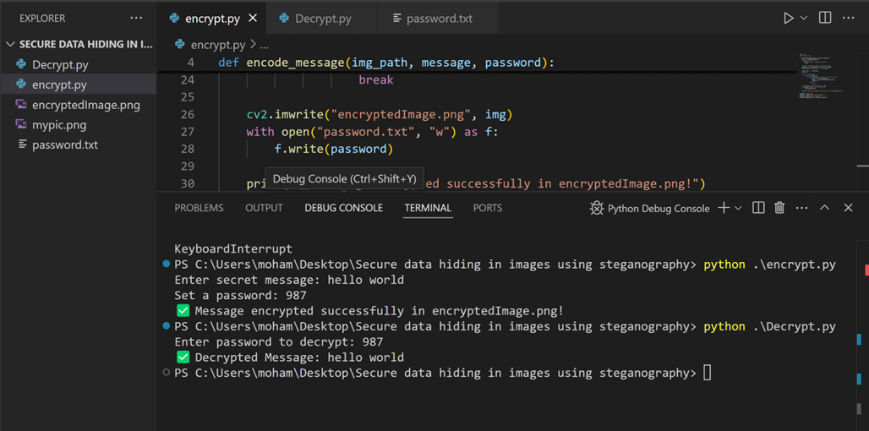
Results

Slide 9
Conclusion
The Secure Data Hiding in Images Using Steganography project successfully demonstrates how confidential information can be embedded within images without altering their visible properties. By leveraging image steganography, the project ensures that sensitive data remains hidden and accessible only to authorized users through a password-protected decryption process.
This technique enhances data security, privacy, and confidentiality, making it an effective solution for secure communication and information protection. The project’s ease of use, efficiency, and robustness make it a viable approach for various real-world applications, including secure messaging, digital watermarking, and confidential data transfer.
With further improvements in encryption algorithms and AI-driven detection evasion, this method can evolve into a more advanced and foolproof security solution for digital communications

Slide 10
GitHub Link
https://github.com/saifuddinmohammad/AICTE-Internship-project.git

Slide 11
THANK YOU

